Slide 1
SQL Server
Creating and Altering Tables with the GUI
In all slides, db=database

Slide 2
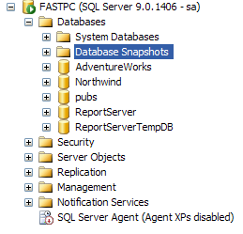
GUI
With the databases node expanded, you should see something like this:

Slide 3
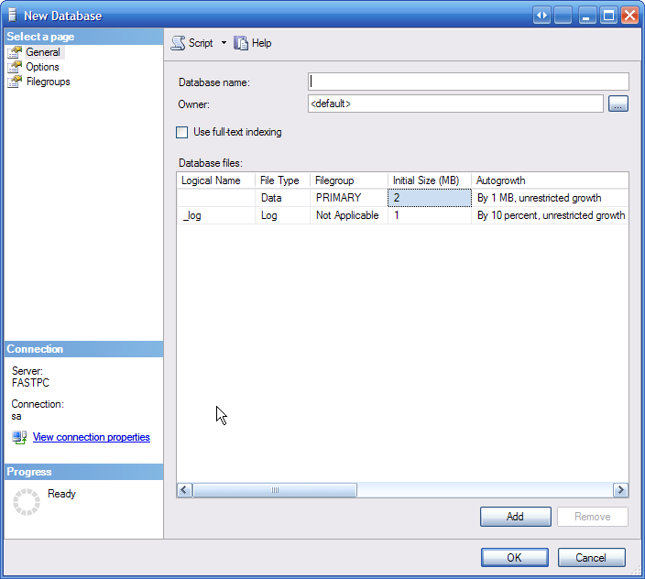
Adding a new database
Here you
can give
the db
a name
and specify
the owner.

Slide 4
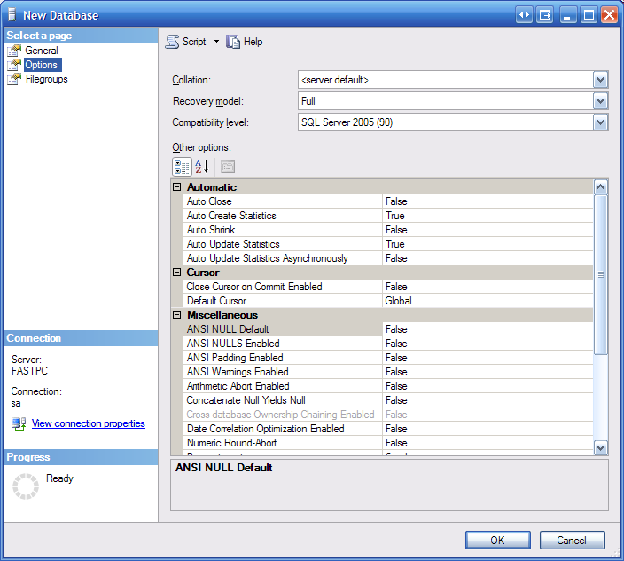
Adding a new database cont.
Options tab. Until you get into more
advanced issues,
it is safe to leave
these at default.
Click ‘Ok’ to
create the db.

Slide 5
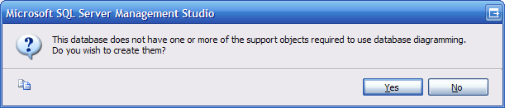
Database Diagrams
You can view a diagram of your database or use it to create or alter objects in your database. Right-click Database Diagrams, and you’ll get a dialog indicating that the database is missing some objects it needs to support database diagramming:
If you wish to proceed into Database Diagrams, choose ‘Yes’

Slide 6
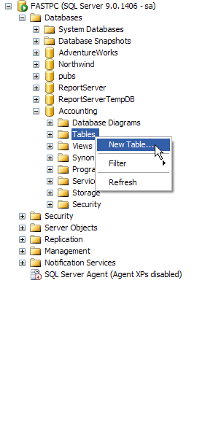
Add Table cont.
Another way (other than
Database Diagrams) to
create tables is to right
click on tables, and
choose ‘New Table’:

Slide 7
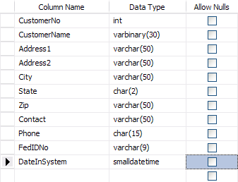
Add Table cont.
This allows you to fill in your table – one piece at a time:

Slide 8
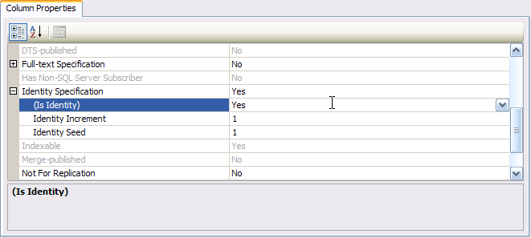
Add Table cont.
We also need to set our identity column.
Set the identity in the column property area:

Slide 9
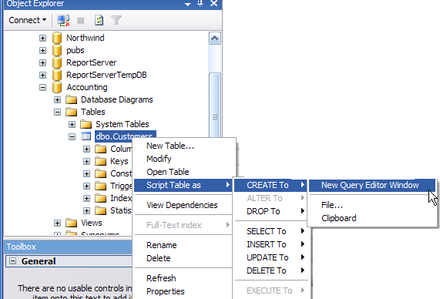
Creating Scripts
To generate scripts, right click on the db to have the scripts generated from:

Slide 10
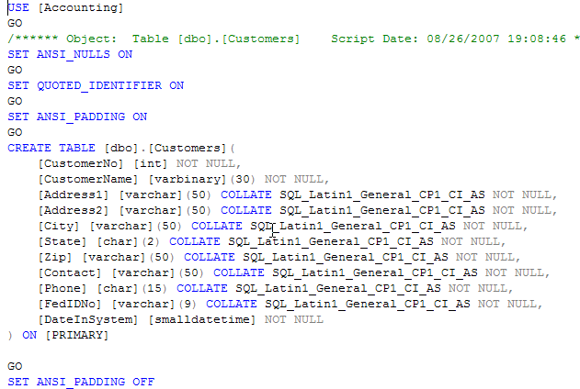
Creating Scripts cont.
Using this tool, we can create scripts for just about any purpose.

